Slide 1
Programming Robots

Slide 2

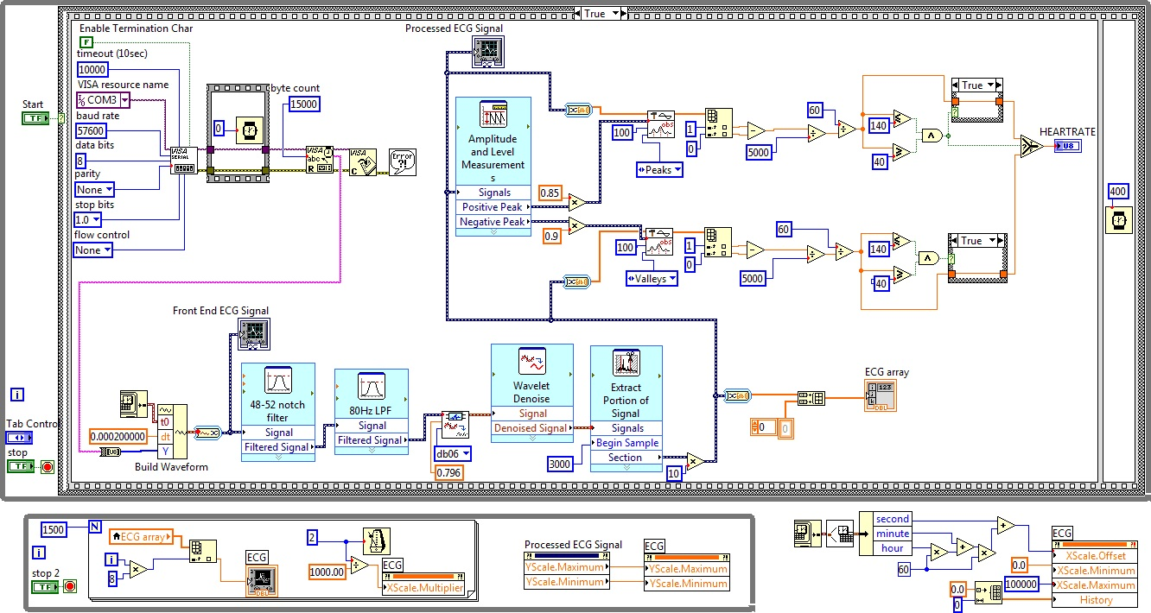
LabVIEW
it's a meme
lacks features
easy to use/learn
slow
strange bugs
expensive (can only install on one pc)
not real programming

Slide 3
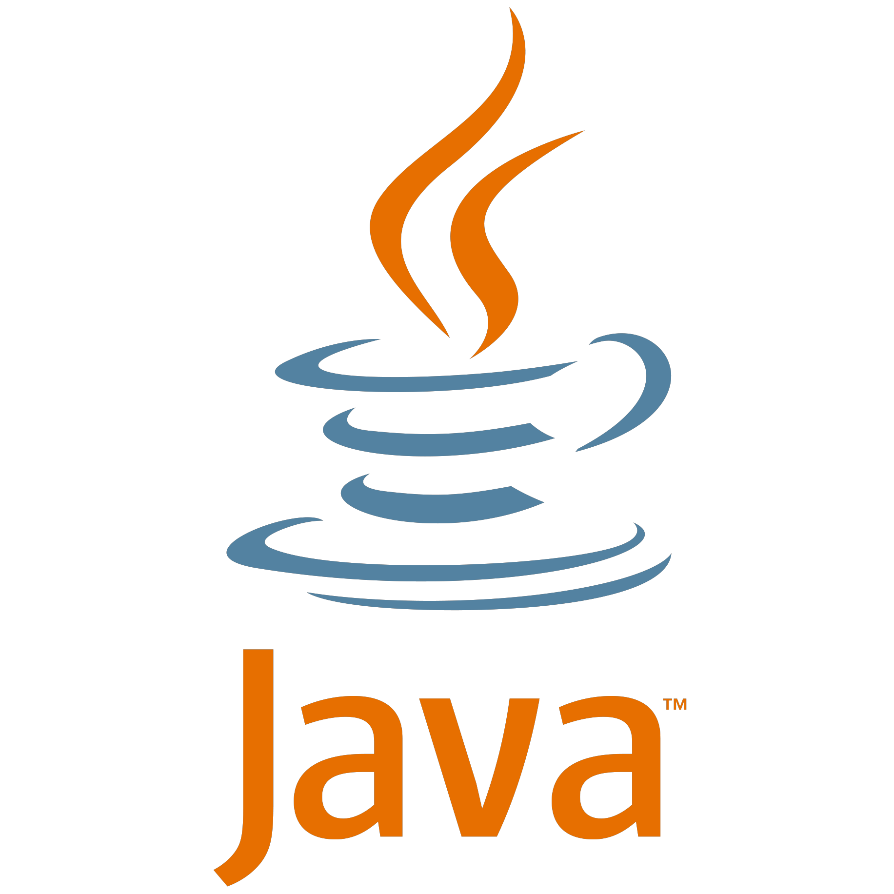
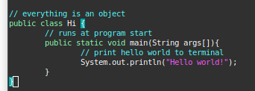
Java
Good for the AP computer science exam
Becoming a dead language
Very wordy, OOP and rigid constructs
Popular and well supported
Language not designed for this

Slide 4


Python
Slow
Easy to read and write
Supports a variety of programming styles
Growing in popularity
Still experimental (no official support)
Language/Interpreter not designed for this

Slide 5
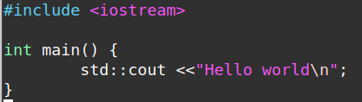
C/C++
Hardest to learn
Concise
Most powerful
You can use this language for almost anything
Ideal language for this purpose
Allows direct hardware access if needed
Supports a diversity of programming styles.

